Slide 1
A warm welcome from The School of Computer Science at Leeds Trinity University

Slide 2
WHAT’S COVERED…
Types of Jobs in Computer Science ​
Our Computer Science Team​
Course Structure including Placement​
Why LTU for Com Science?​
Basic Python, and Programming Activity

Slide 3







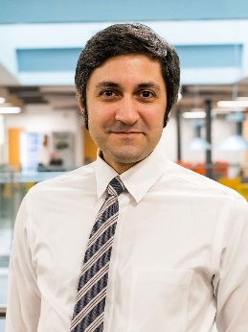
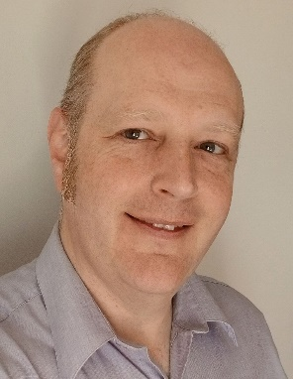
COMPUTER SCIENCE TEAM
Professor Yanguo Jing
Dr Nicole Danino
Dr Antesar Shabut
Mr Jim Diockou
Dr Aliyu Lawal Aliyu
Dr Lesley May
Dr Xin Lu
Dr Yashar
Baradaran Shokouhi
Dr Nick Mitchell
Examples of research within the school: ​
​
AI in healthcare and Biomedical Signal Processing ​
Cyber Security and the future of air commute ​
Software Defined Networks (SDN) & 5G​
Opensource research​
Globaliser Mobile App

Slide 4
POTENTIAL JOBS IN COMPUTER SCIENCE
Web Designers, App Developers, Games Designers, Cyber Security, Algorithm Developers, Data Analytics, AI & Machine Learning Lead, …
Read more …

Slide 5

Available Courses
Currently available programme: ​
BSc Computer Science (BCS Accredited) ​
MSc Data Science and AI (Scholarships available) ​
Computer Science with Artificial Intelligence ​
Computer Science with Game Development​
Computer Science with Cyber Security​
Foundation year available.

Slide 6
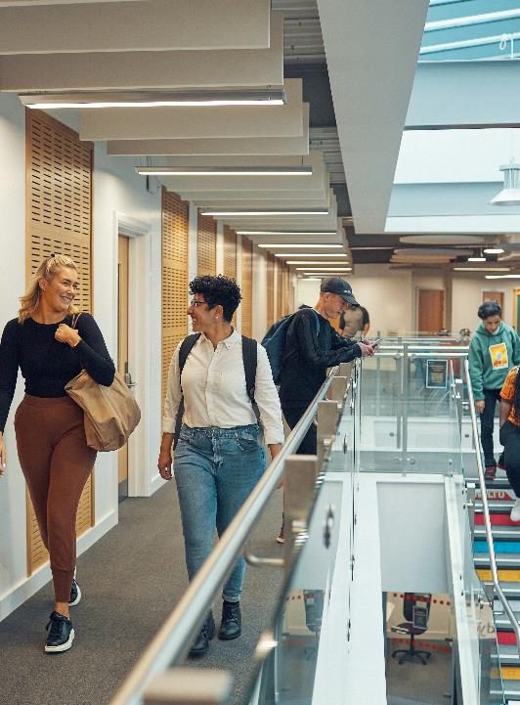

COURSE STRUCTURE
BSc Computer Science​
Notes:
A mark of assurance that the degree meets the standards required by BCS for a Higher Education course.
As a graduate of the BCS-accredited course, you can register with BCS as a Chartered IT Professional (CITP) and/or Chartered Engineer (Partial)
This can help you stand out in job applications and support your career progression.

Slide 7
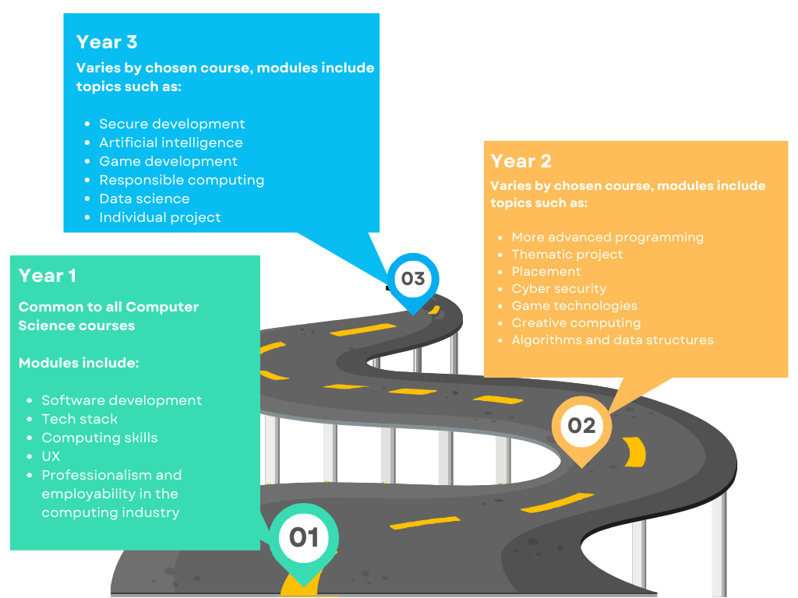











How we structure our course:

Slide 8
Foundation Year
Most of our undergraduate degrees can be taken as a four-year course, beginning with the associated Foundation Year for your chosen degree.
Aims to develop your academic knowledge​
Introduces you to key concepts in Computing​
Develop technical skills in preparation for the BSc course​
Has lower entry requirements than our standard ​
three-year degree

Slide 9
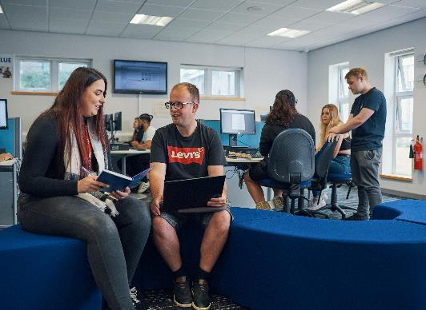
WHY LTU?
Most of our graduates are in employment or further study 15 months after graduating (>93%)​
A supportive university community​
Staff availability ​
Small group teaching​
Industry-led teaching and mentoring

Slide 10
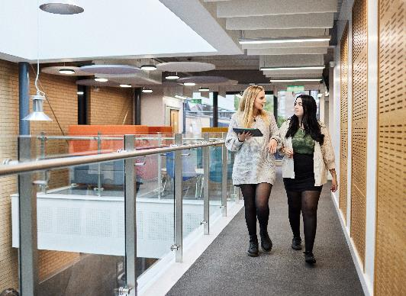
WHY LTU?
Industry & Research​ Led Teaching
Visiting Lecturers from ​
Industry​
Royal Academy of Engineering​
Industry visits, events and placement opportunities
Notes:
Professional work placements and live employer projects
Research and industry-lead teaching
Academics with a wide range of expertise
Addresses in-demand skills gaps
Links with tech companies in and around Leeds
Smaller class sizes offering excellent levels of personal support
24/7 remote access to computing labs and to professional tools, resources and guidelines
Accredited by the BCS, The Chartered Institute for IT

Slide 11
Professional work placements
Partners:
UST
Apporto
Example of other companies:
Hippo Digital
Legal Tech
Farnell
Samsung
And many others

Slide 12
Leeds Tech City
Examples of the range of tech companies actively recruiting in Leeds and West Yorkshire include:
Media
Health
Fashion
Gaming
Enterprise Software
Marketing
Fintech
Wellness Beauty
Kids
Food
Event Tech
Transportation
Energy
Home living space
Service Provider
Sports
Real Estate
Job Recruitment
Space
Travel
Finance & Banking
Property Sector
Legal Firms
Government
Universities – Academic route
Energy and Renewable Energy
Net Zero Carbon Sustainability
Construction
Big Tech Companies
Automation and self-driving vehicles
Cyber Security Analysts
Notes:
Talk about how AI bring new jobs: AI Prompt engineering, AI vehicle control rooms to control drones, cars, taxis, buses, etc (5-10 engineers sitting in a room controlling over 100 vehicles)
You can also mention when the robots came along, some ports were automated, but robots created load of other jobs.

Slide 13
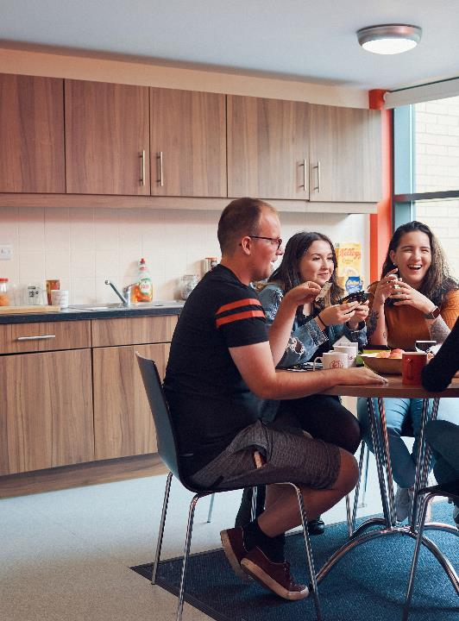
Study abroad
We partner with universities, institutions, employers and charities across the world to give you amazing opportunities to have an international experience. This may include:
Studying abroad for a full academic year
International volunteering
Short-term international trips

Slide 14
Contacts
Dr Yashar Baradaranshokouhi​
Yash.b@leedstrinity.ac.uk​
Dr Nicky Danino (Head of School)​
n.danino@leedstrinity.ac.uk​
Thank you for listening​
Any questions?

